Slide 1
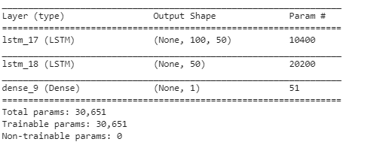
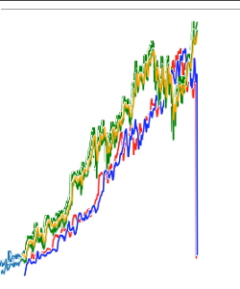
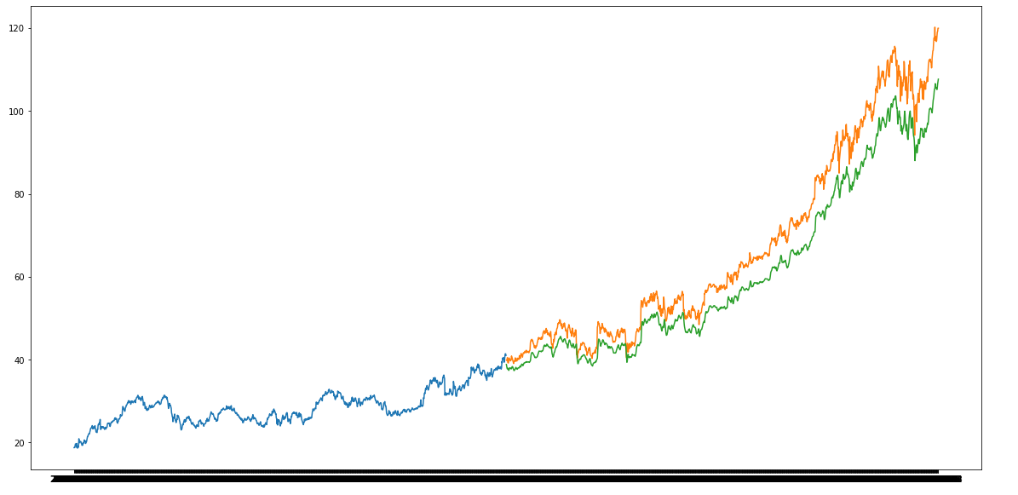
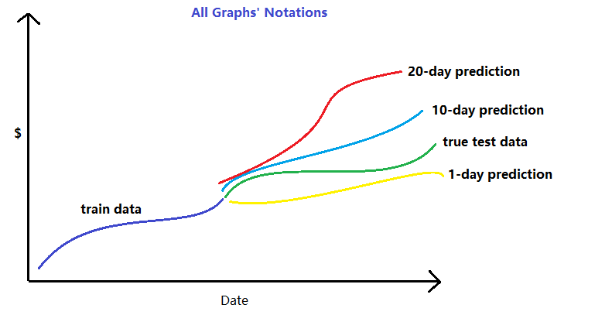
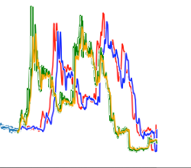
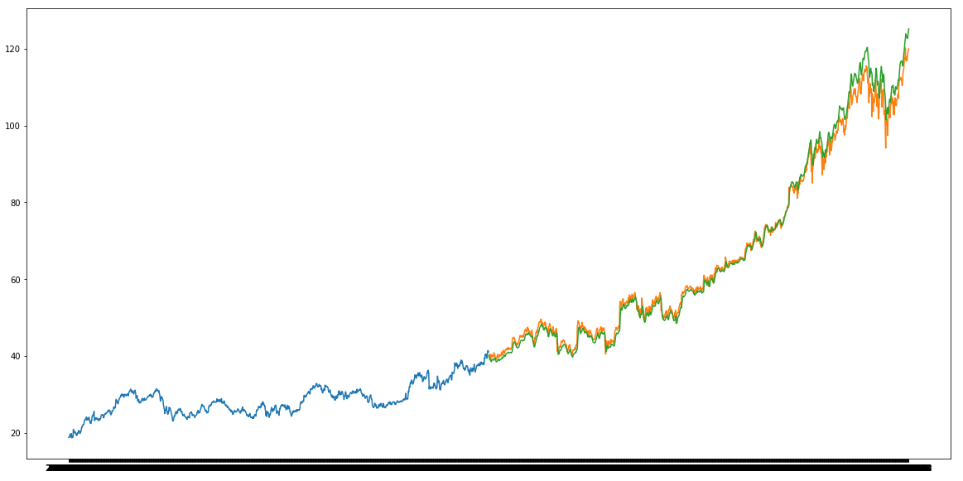
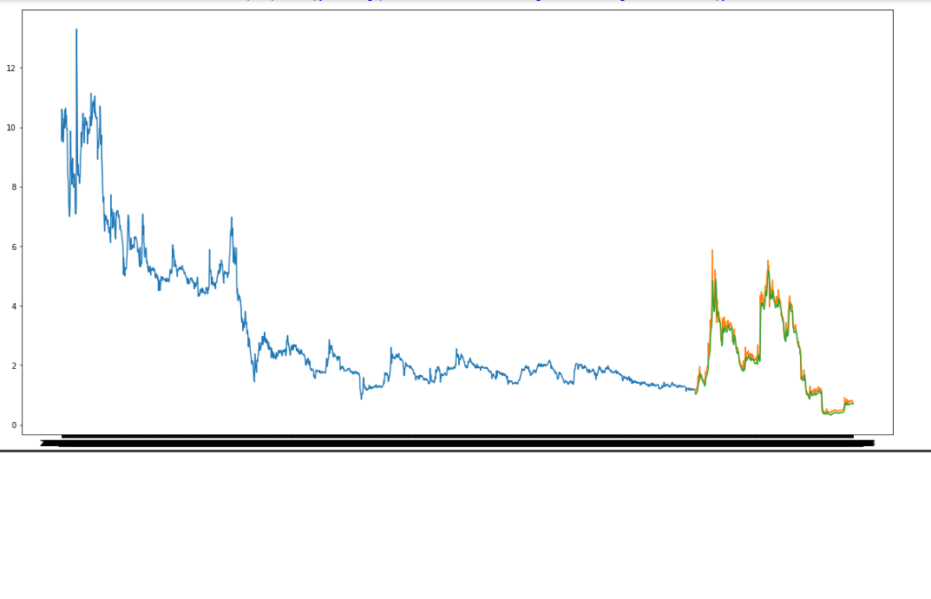
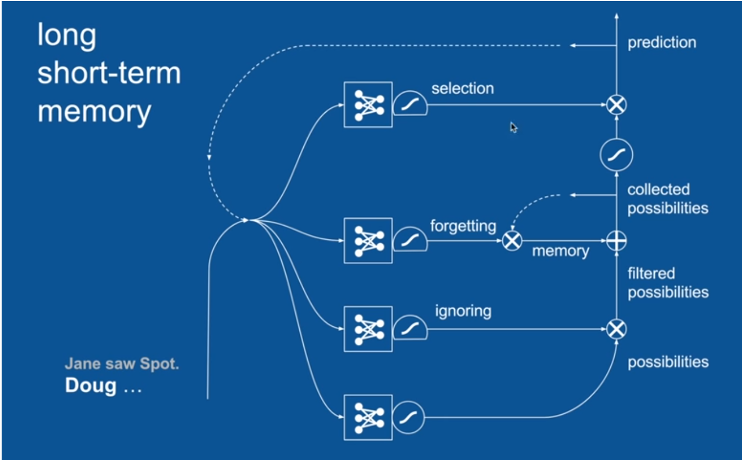
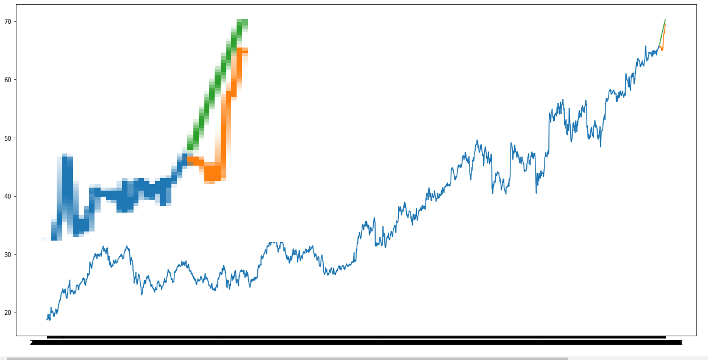
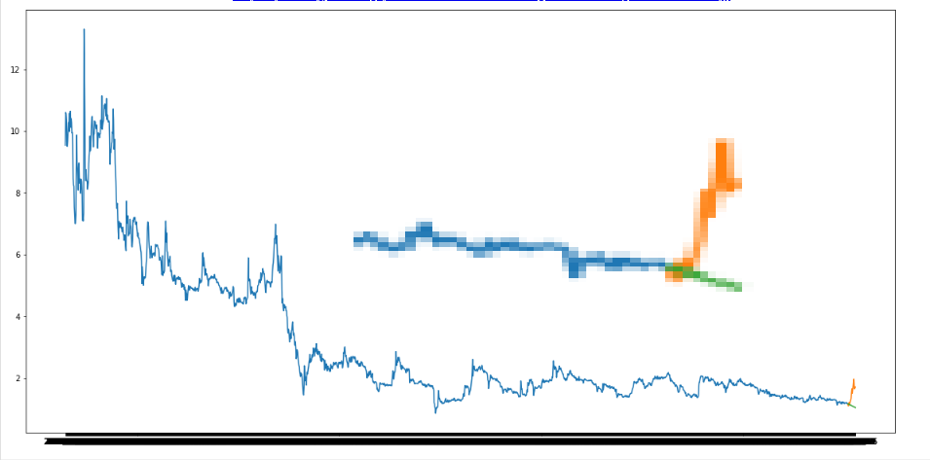
Machine Learning for Efficient Genome Assembly Construction: A Ranking-based Approach
Ngoc Duong, Marcus Blaisdell
Washington State University
Introduction
Results
ML challenge. Stock is known to be unpredictable because of trends and seasonal reasons.
Data is time-dependent.
So far in class, we have only learned how to predict data based on dependence of features. To predict stock data, we need to develop a ML model that predicts data based on time features.
https://drive.google.com/open?id=1_hRa5kEiLtxAJQYe_0UJRcowexbVLIhc
Method
10 years of stock market data was obtained from NASDAQ (National Association of Securities Dealers Automated Quotations) for Microsoft and Zion Oil & Gas
Data was analyzed to test if it was stationary (predictable), Microsoft is stationary, Zion is not stationary
Data was normalized to prepare it for use in the model
Key attributes were selected, the stock daily closing price was used for prediction
Since the data is time-dependent, an LSTM model was chosen
Hyperparameter tuning was performed using Lag and epochs
Batch size
Microsoft
 | 1 Day Prediction | 10 Day Prediction | 20 Day Prediction
Microsoft $^2
Zion $^2 | 0.06363 | 3.1612 | 3.3739
Lag = 60, 1 Day prediction
Zion Oil & Gas
Conclusion
LSTM model is x% accurate at short-term predictions and becomes less predictable as the length of prediction increases
LSTM works on data regardless of whether it is stationary or non-stationary
LSTM can be trained with a small number of epochs, is effective with a small number of epochs
MSE always less than 1e-3
Lag = 100, 1 Day prediction
Lag = 100, 1 Day prediction
Figure 1: LSTM mechanism₁
Acknowledgements
₁ Rohrer, Brandon, (2017, June 27). Recurrent Neural Networks (RNN) and Long-Short-Term Memory (LSTM)[Video File]. Retrieved from https://www.youtube.com/watch?v=WCUNPb-5EYI
Next Steps
Improve the long term prediction success by using different neural network models, experimenting with the number of hidden layers, combining more features and incorporating outside data from news sources
More hyperparameter tuning
Lag = 100, 20 day prediction
Lag = 100, 20 day prediction

